Slide 1
The In2STEM programme
Kick-start your journey to a successful STEM career with
Notes:
Welcome
I’m Neda, Programme Officer at In2scienceUK and my colleagues X and X are also here
Thank you for your interest in the In2STEM programme - formally In2science summer programme
Today: talk about what In2scienceUK does and then about the opportunity to get involved
Any questions throughout pop them into the chat or make a note. There’ll be time for questions at the end
I2S is a charity helping young people from traditionally underrepresented and disadvantaged backgrounds access STEM careers, apprenticeships and degrees

Slide 2
Why should you apply?
A hands-on work experience placement hosted by STEM professionals. Connecting students to experts working at the cutting edge of research and innovation! A bursary is provided to cover food and travel costs.
Online skills, employability and careers workshops, connecting students with like-minded peers and experts, sharing knowledge, and helping students with their next step towards university, apprenticeships and a STEM career.
Public engagement competitions with prizes, giving students the opportunity to showcase their creative side and communicate what they have learnt on their work experience placement.

Slide 3
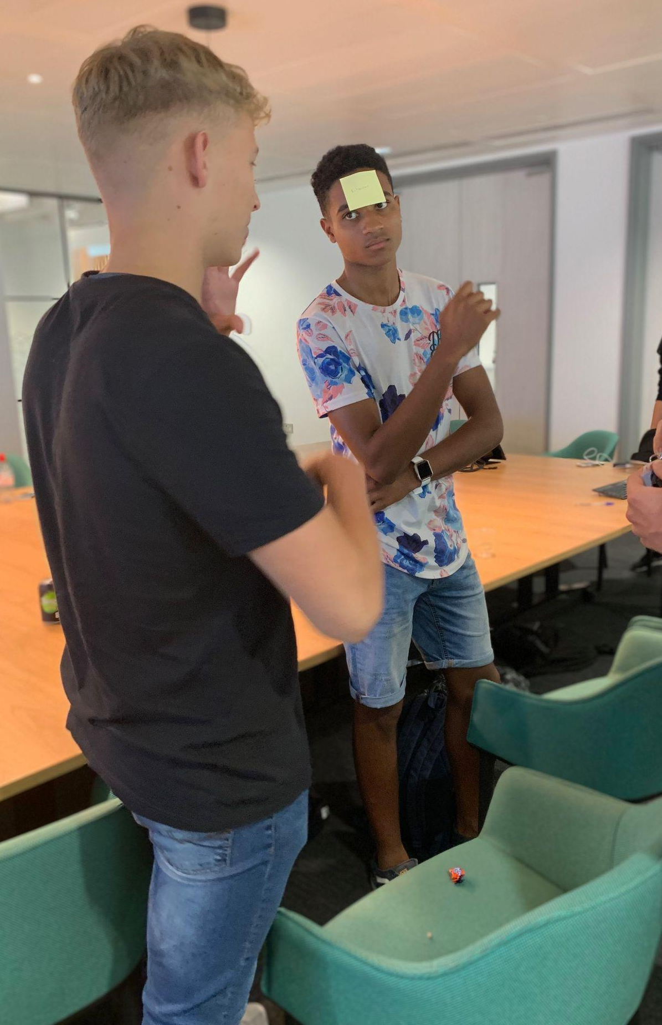
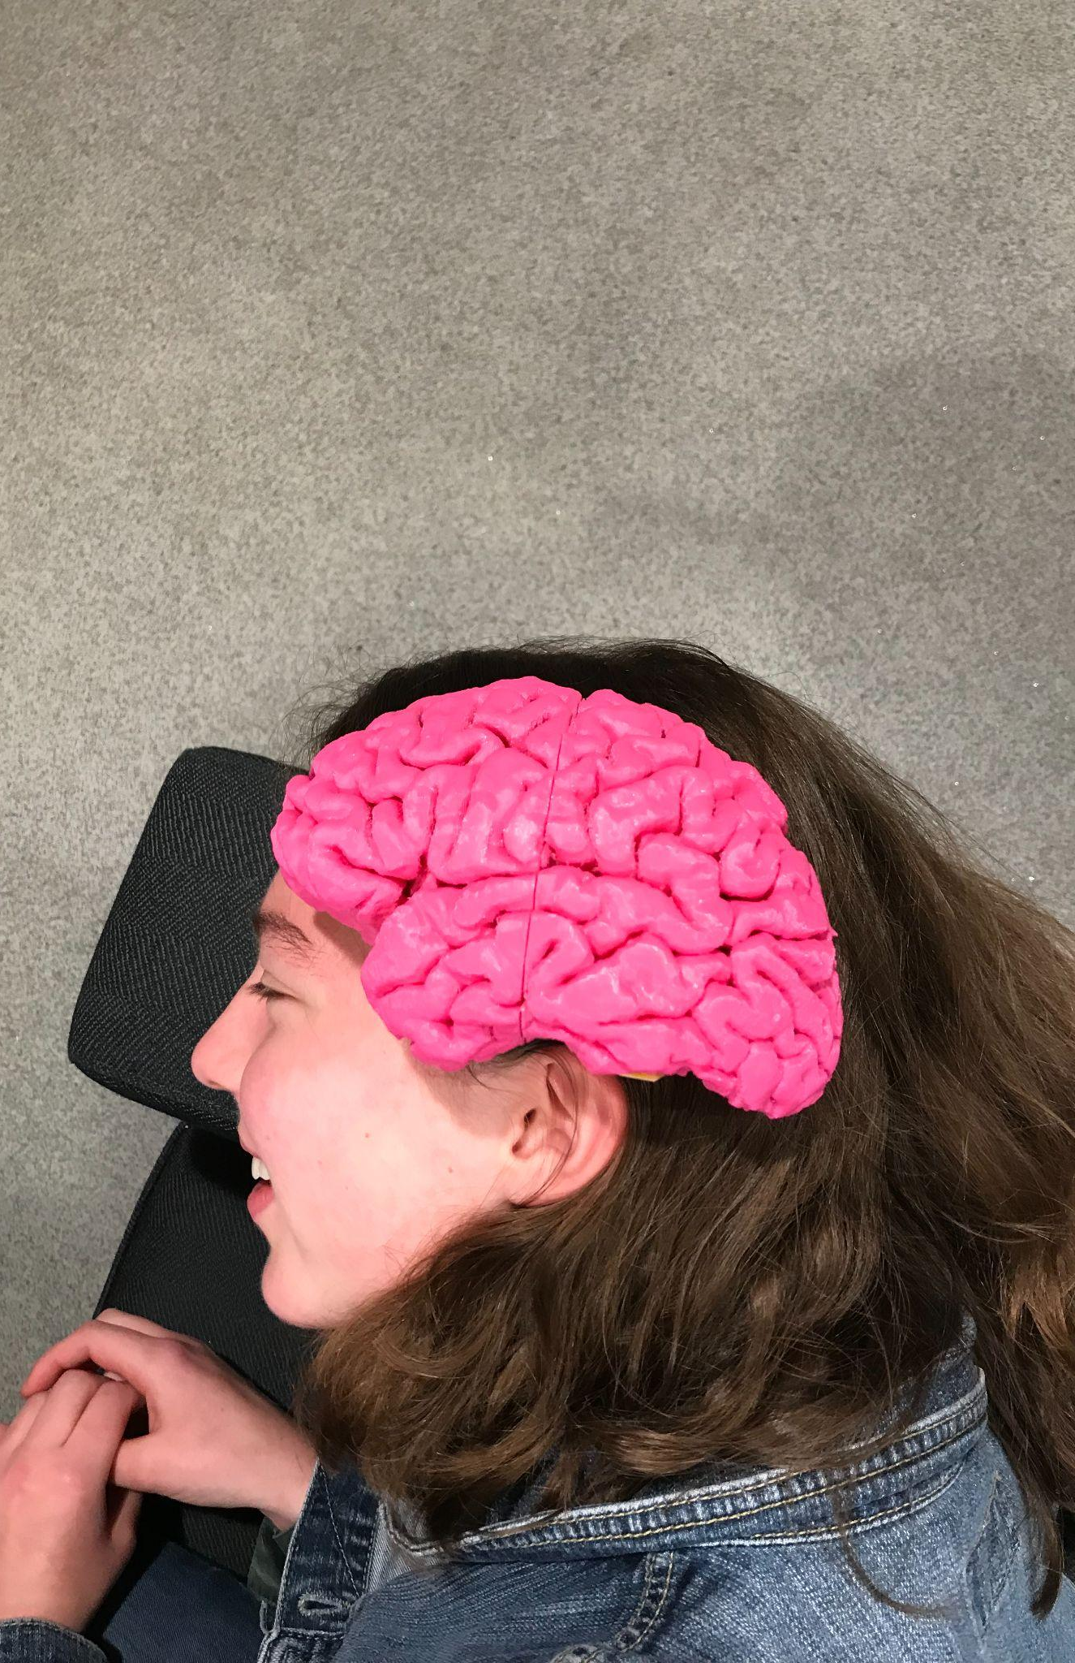
The In2STEM programme
Student Induction
Events
1 or 2 week In-person Work Placement
Online Skills, Employability and Careers Workshops
Public Engagement Competitions
Celebration Events

Slide 4
Work Experience Placements
Usually in groups of 2 or 3
Matched with a STEM host who works in their subject area of interest (or as close to it as possible)
Within commutable distance
Welcome briefing
Experiments
Data analysis
Scenario task
Mock interview
Advice

Slide 5
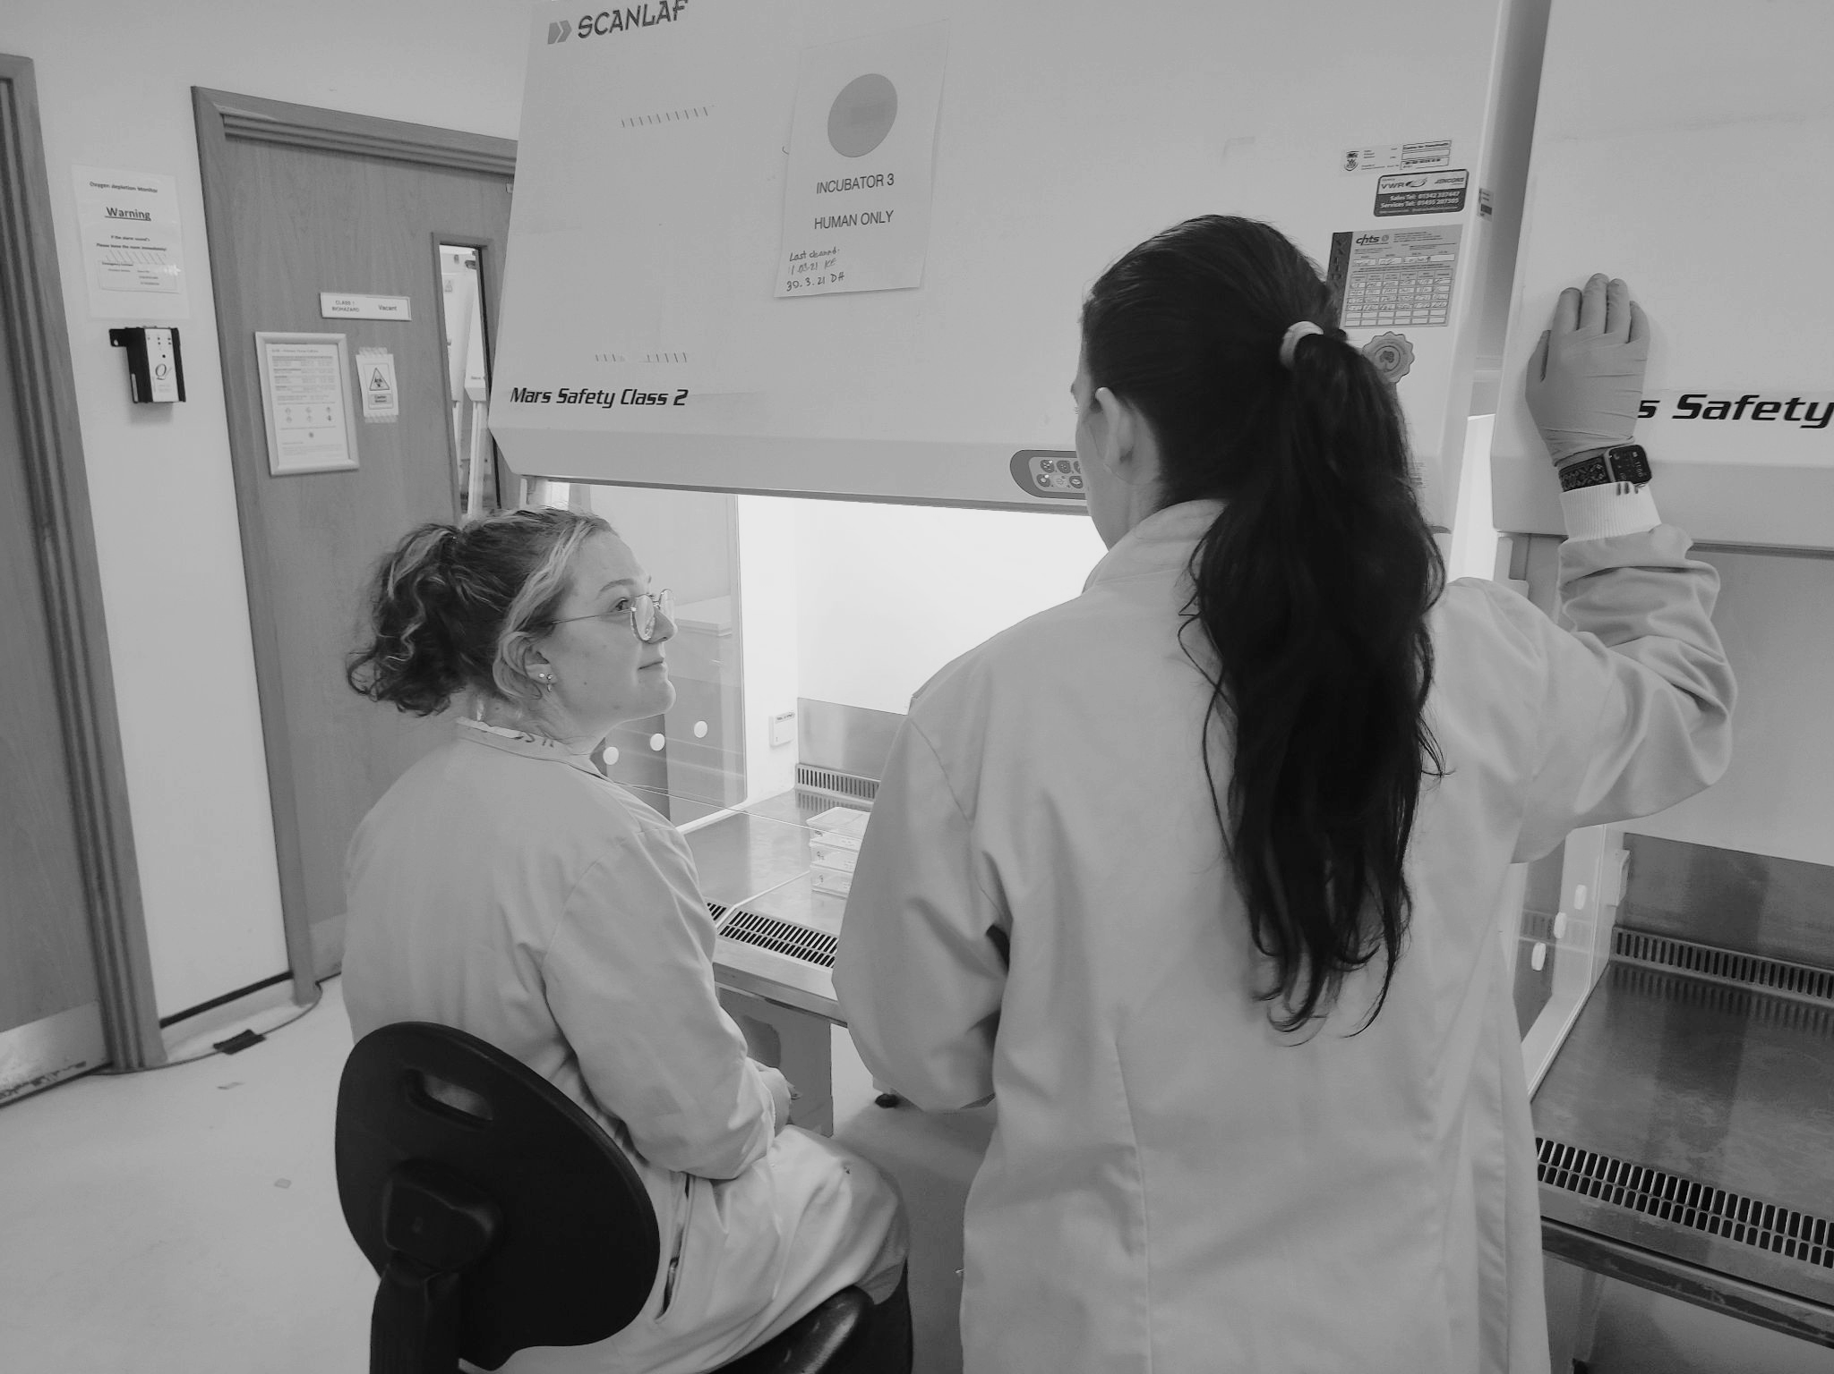
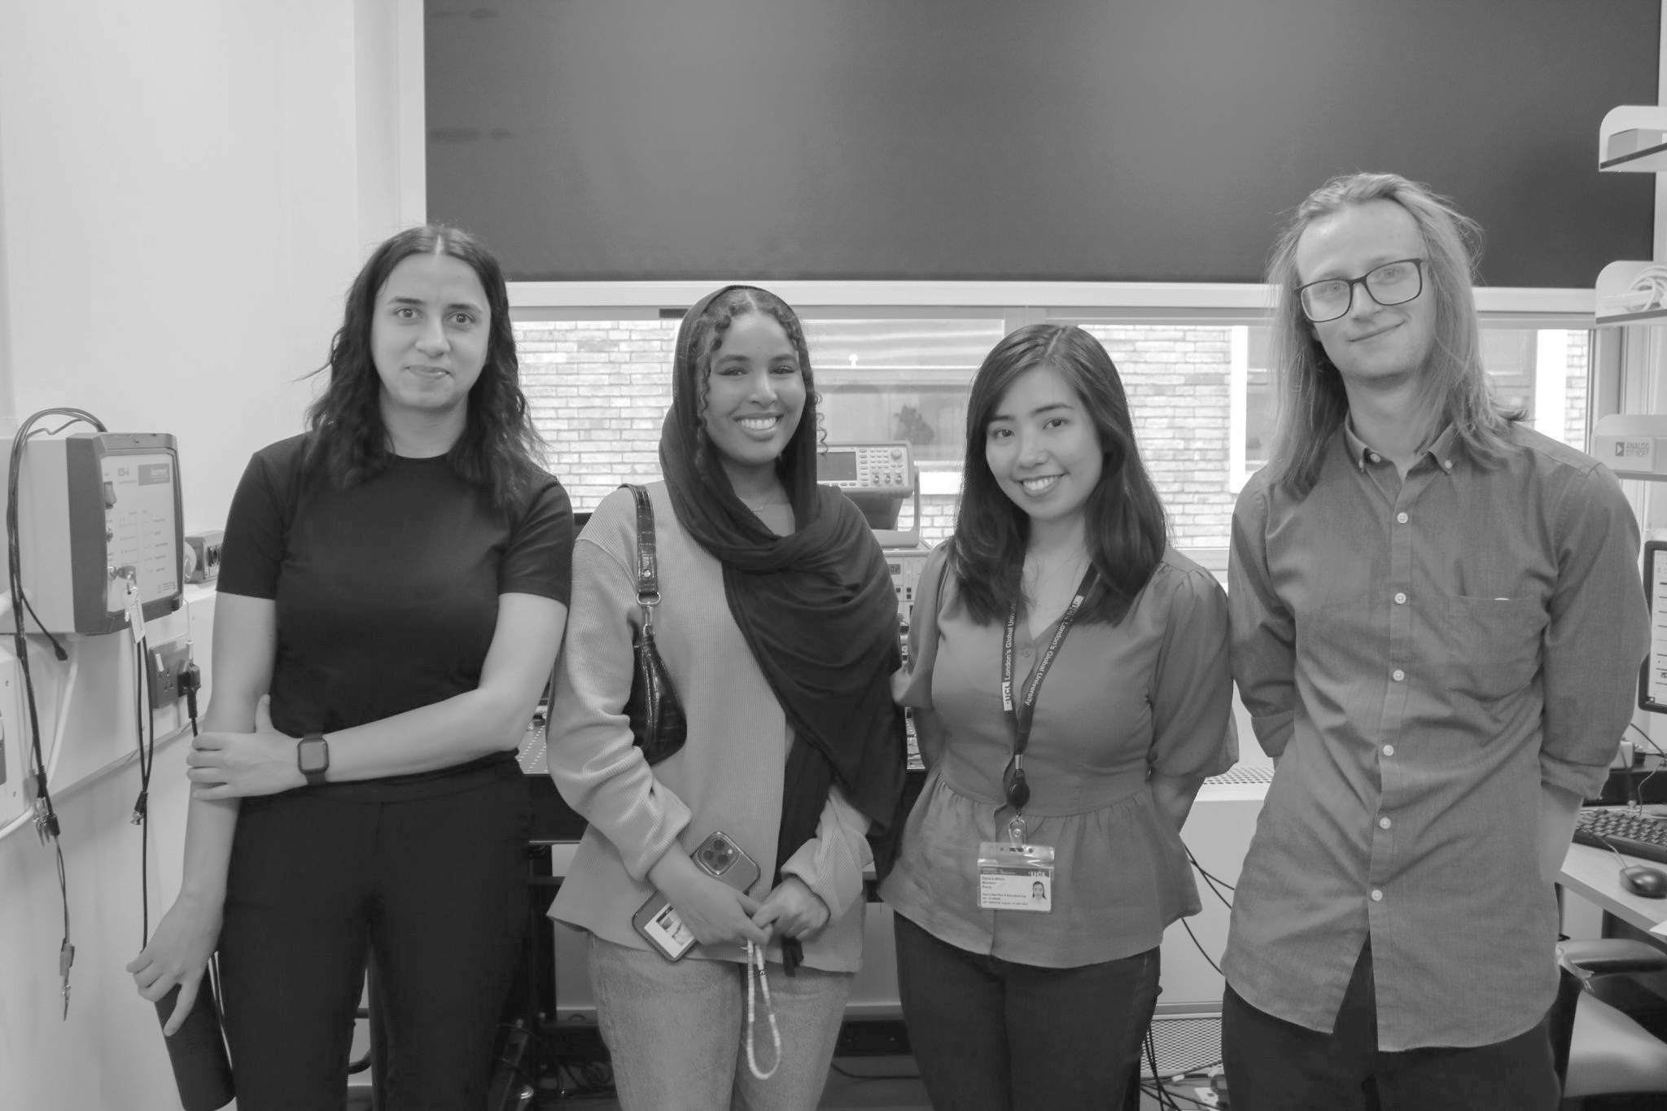
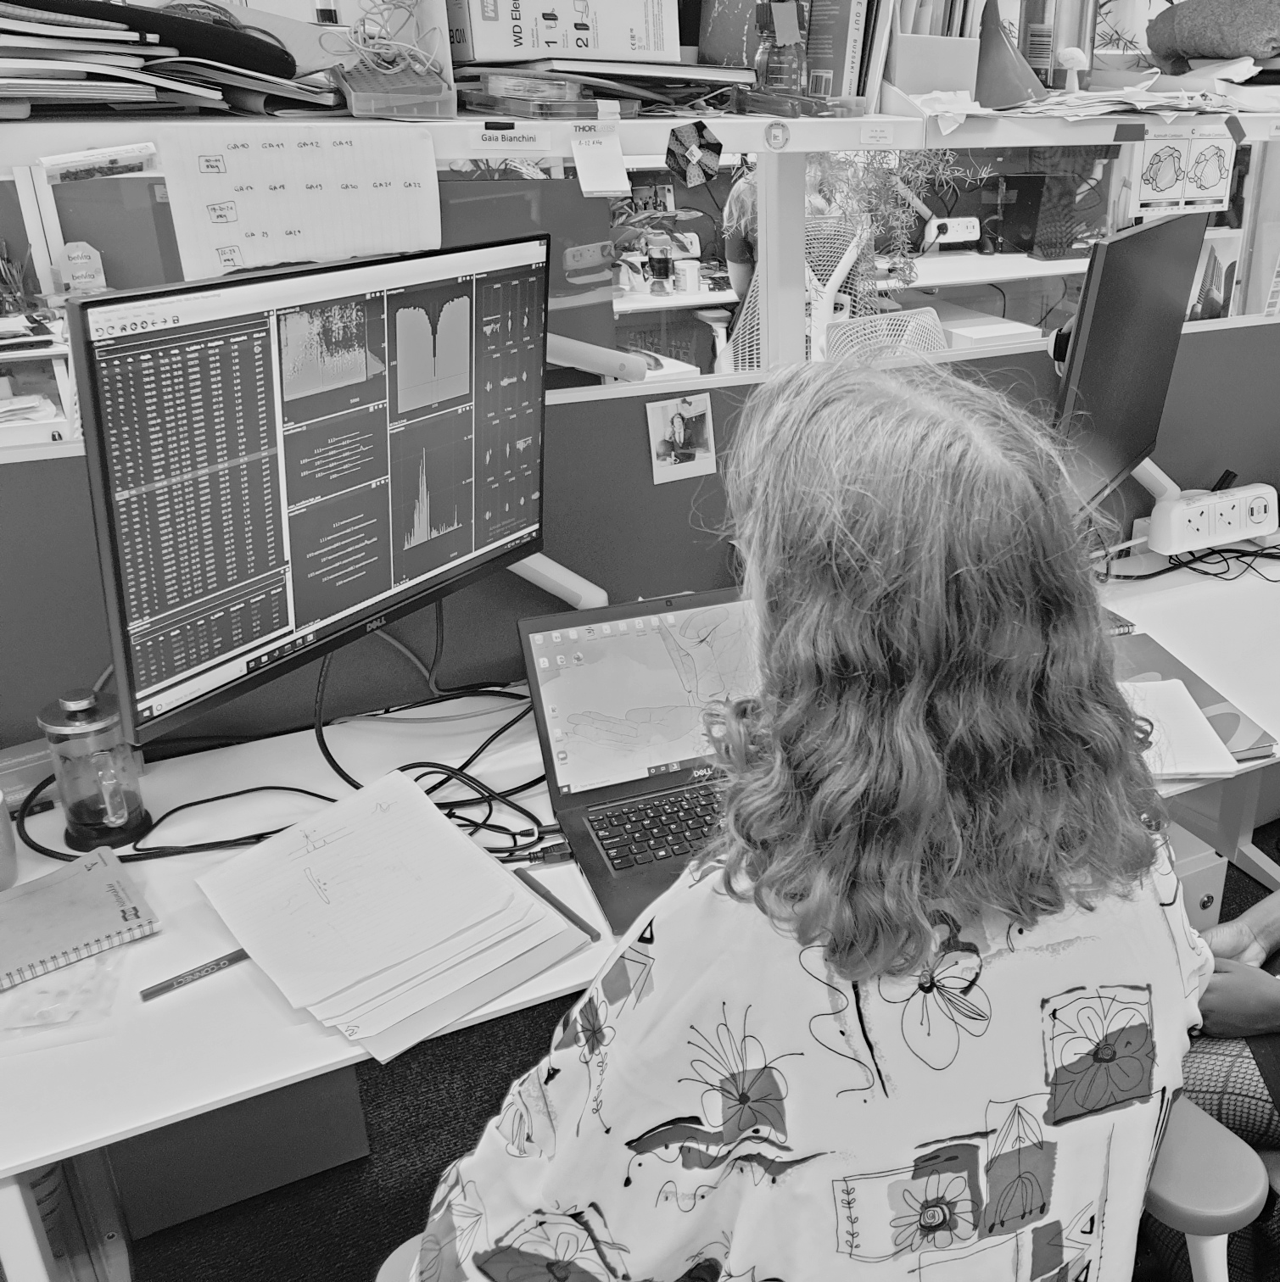
Previous placement examples:
London
Other UK areas
Mathematics at UCL
Cell signalling and networks at Queen Mary University of London
Neuroscience at the Francis Crick Institute
Tech company in Edinburgh
Engineering at MacLaren Applied Limited
Cardiology at Bristol Royal Infirmary Hospital

Slide 6
Online Workshops & Competitions
Skills, Careers and Employability Online Sessions
> Talks from employers and Universities, Careers Panels, Advice on Personal Statements
> Goal Setting, Organisation & Time Management, University Life, Student Finance
Competitions: Blog, Poster & Photo Categories

Slide 7
Key takeaways
You need to be:
You should be:
Attending a non-fee paying/non-selective school
Between 16-19 years old - S5/S6/Y12/college
Studying at least one STEM subject towards A-level, BTEC, Scottish Higher/Advanced Higher or equivalent
Meet some of our additional eligibility criteria
Interested in a career in STEM
Be available most of the 5 weeks (21 July to 22 August 2025)
Be willing to engage with the placement and workshops
Apply by 2 February 2025

Slide 8
Next Steps
Application form - by 2 February 2025
Provide parental consent + teacher reference
Questions: students@in2scienceuk.org
Help us spread the word by telling your friends and sharing posts on social media
Programme is free & bursary provided for lunches and travel

Slide 9
Quotes from previous participants:
Aaliyah, Placement at UCL
“This programme really helped with my confidence when working independently as well as in a team. I felt comfortable voicing my opinion and listening to others too.”
Cleopatra, Placement at Edinburgh Napier University
“I enjoyed the placement as it gave me an insight into different science careers and what it might be like to be a biomedical scientist.”

Slide 10
students@in2scienceuk.org
Thank You
Follow us on Social Media
@in2scienceuk

